Slide 1
Put A Fork In It!
Jodi Riedel
Wakefield High School Agricultural Education and FACS

Slide 2
Agenda Monday, July 10th
12:15 Introductions
12:30 Let’s get growing!
2:30 Break and garden snack
2:45 My favorite “F” word… Fermentation
4:45 Recap and Questions

Slide 3
Agenda Tuesday, July 11th
8:15 Rockin’ Jam Session
9:45 Break and garden snack
10:00 Toilet Paper Shrooms
11:30 Recap, evaluations, questions

Slide 4
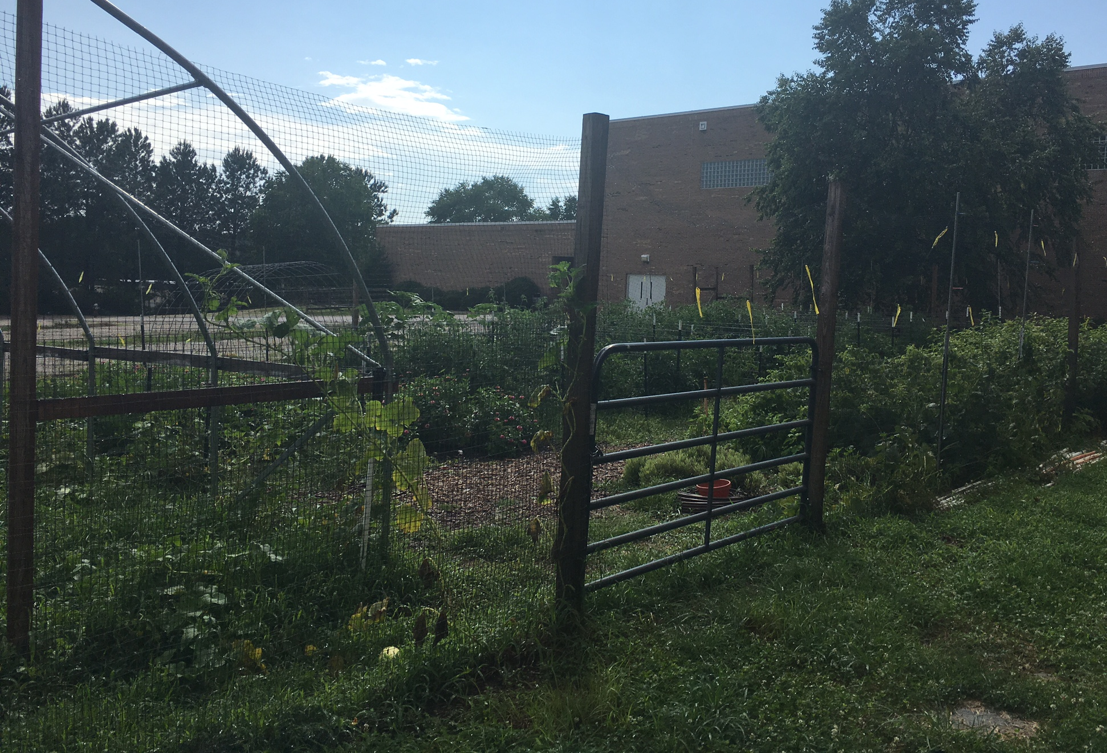
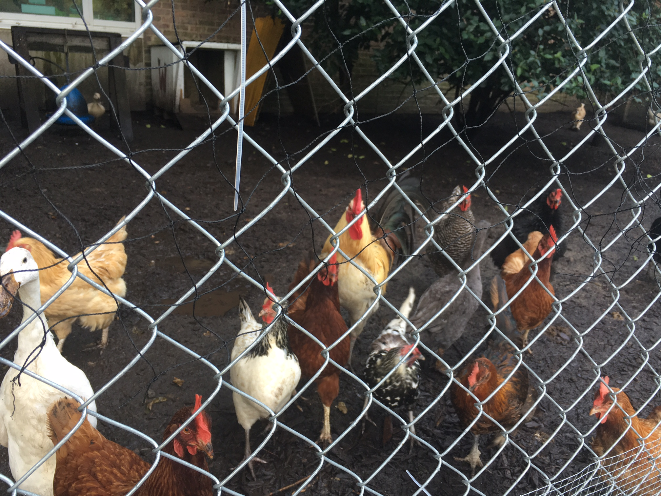
A little about me and what I do.

Slide 5
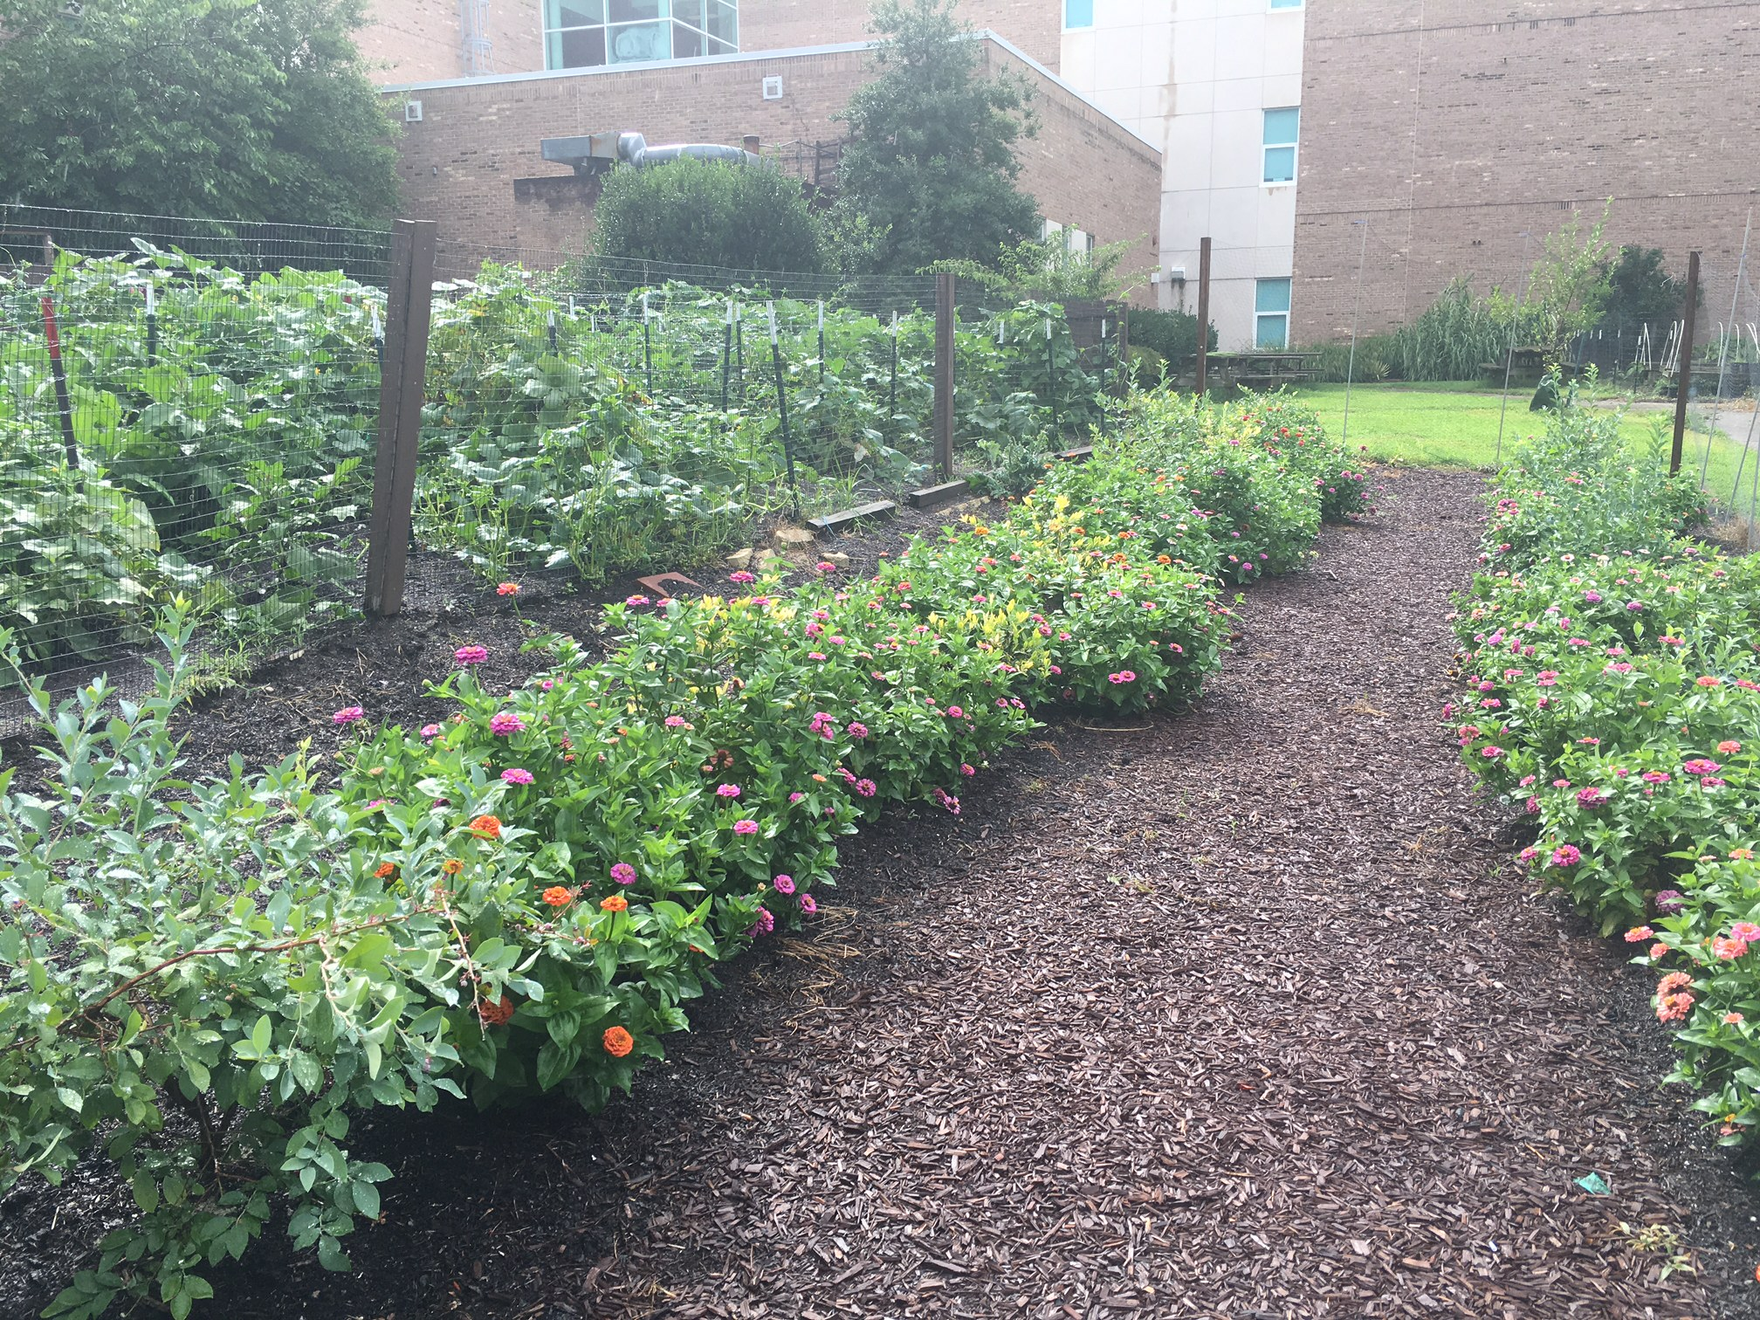
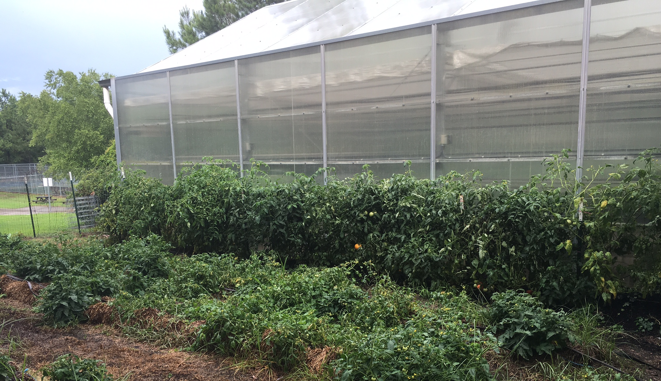
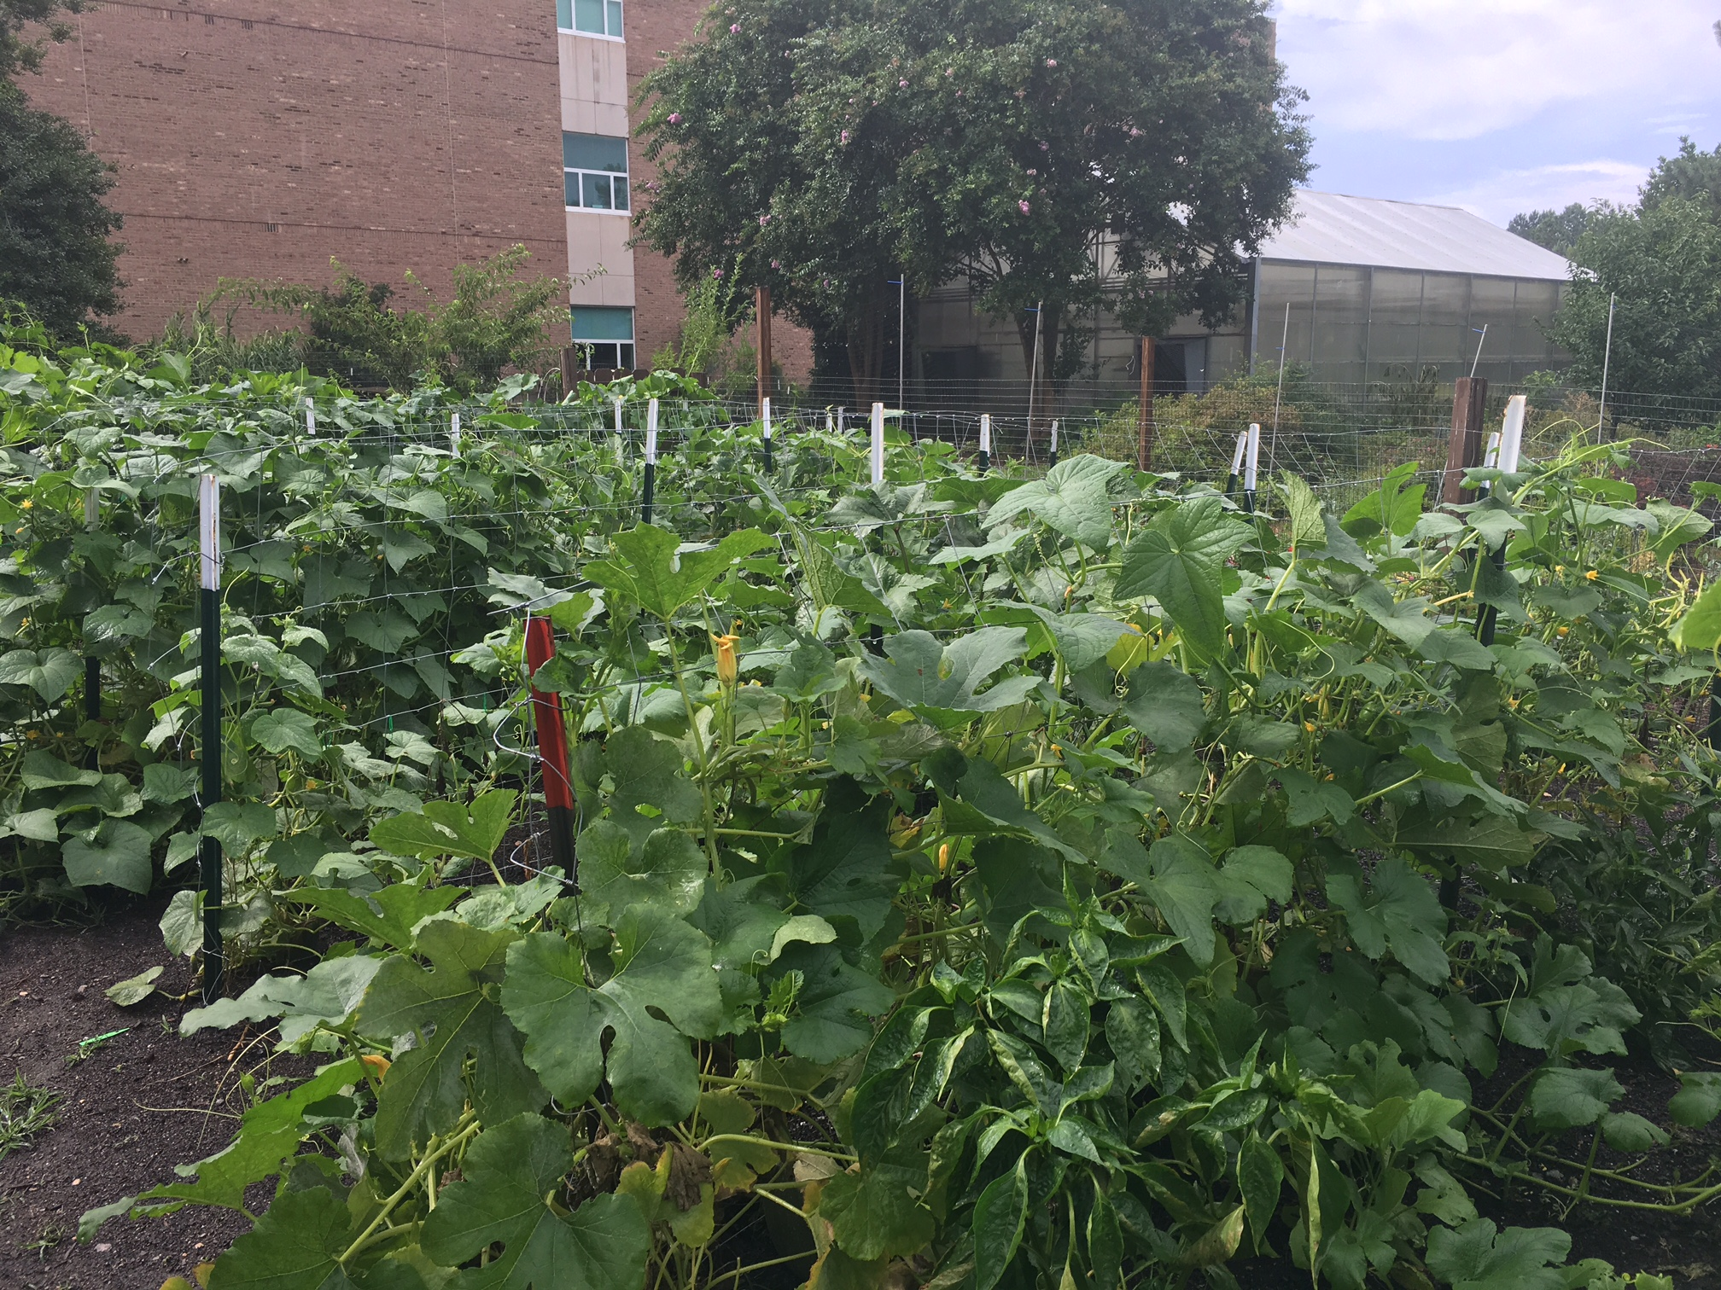
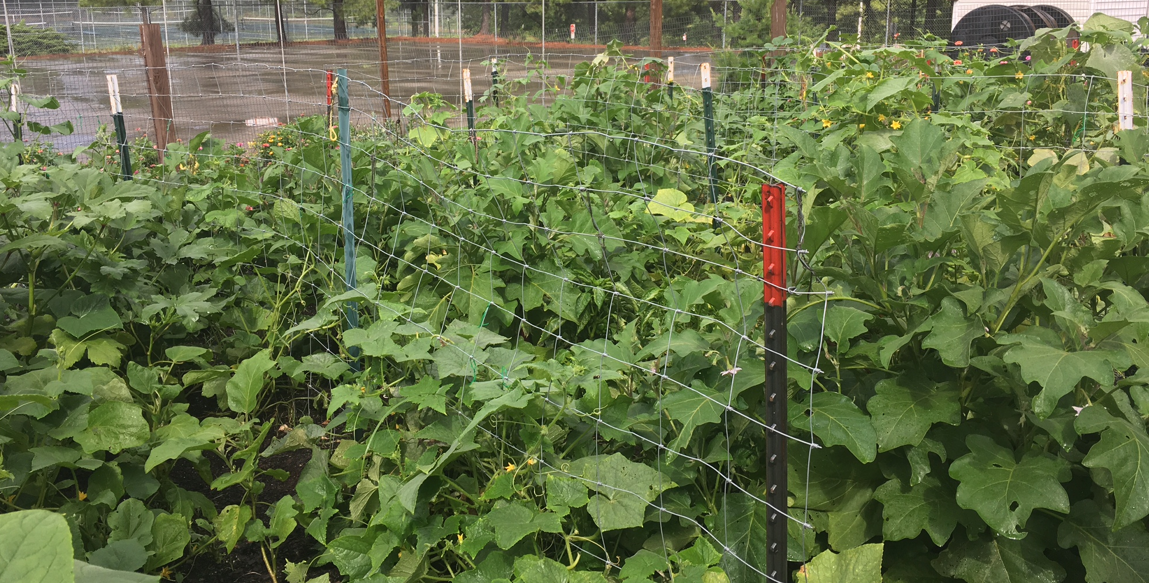
Our farm…

Slide 6
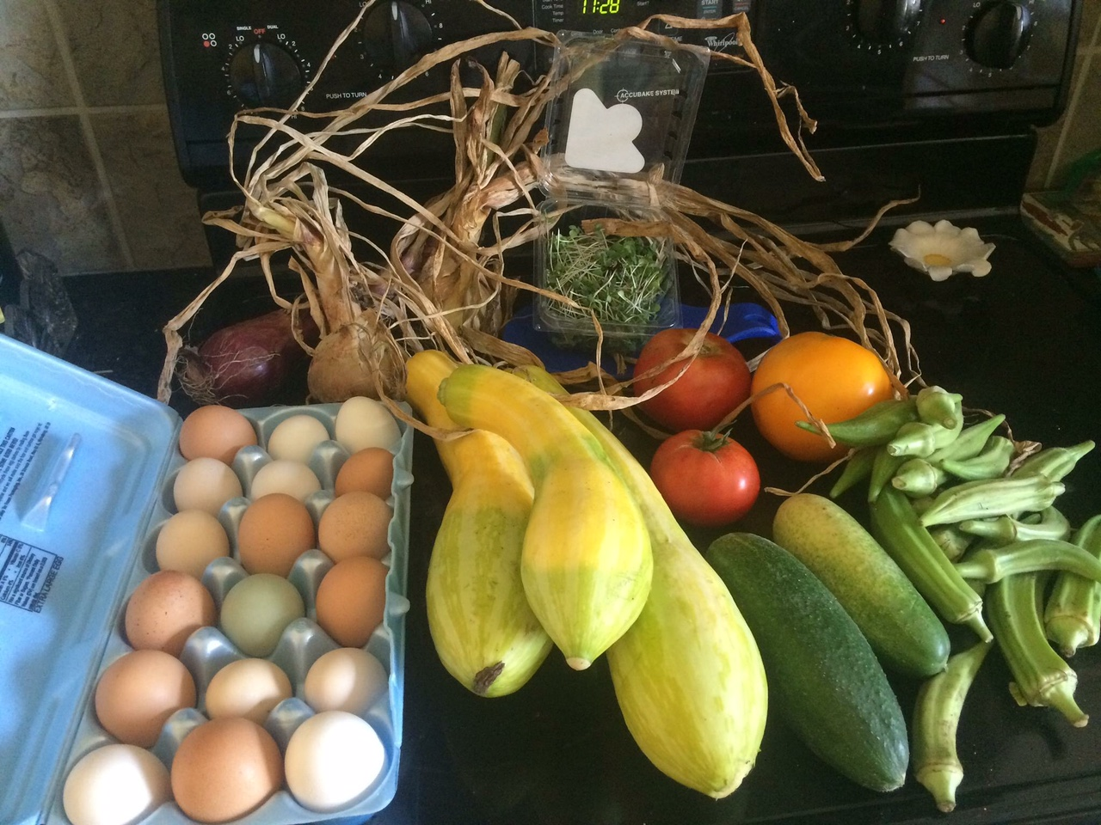
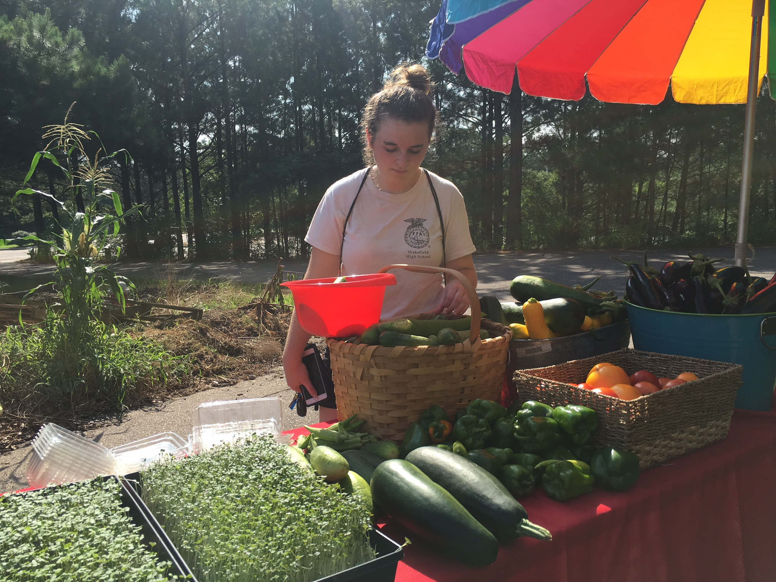
Our business…

Slide 7
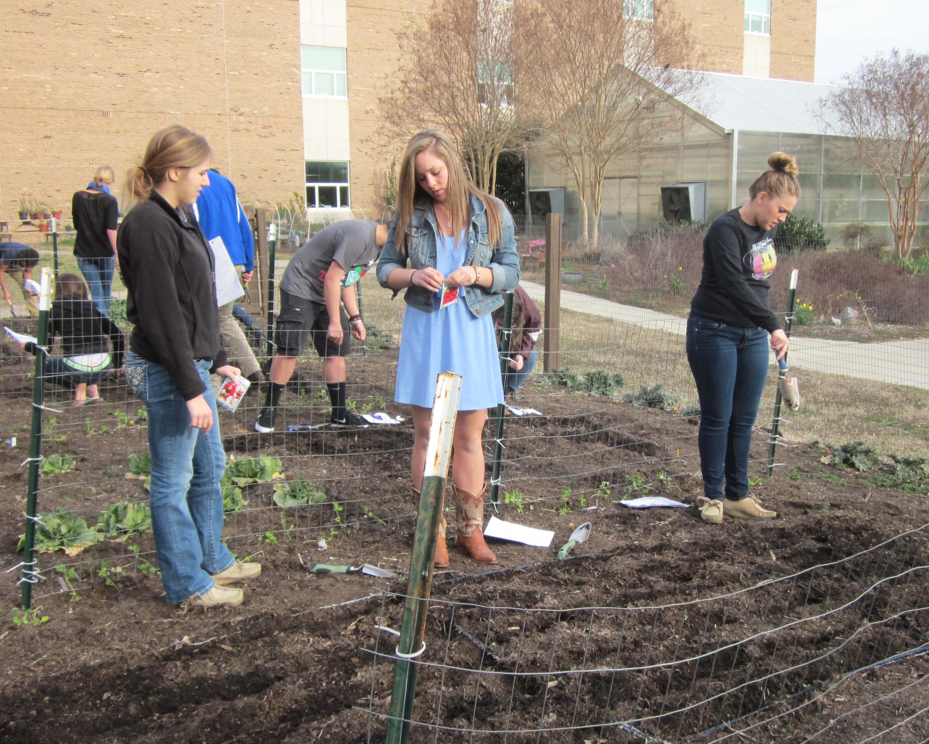
F is for Farming
Radishes
Cheap and easy!
30 days from sowing to eating
Grow them several ways
You don’t need a school garden
Activities
From Rock to Radish
A Spicy Little Radish (Just eat it & Radish cultivation)

Slide 8
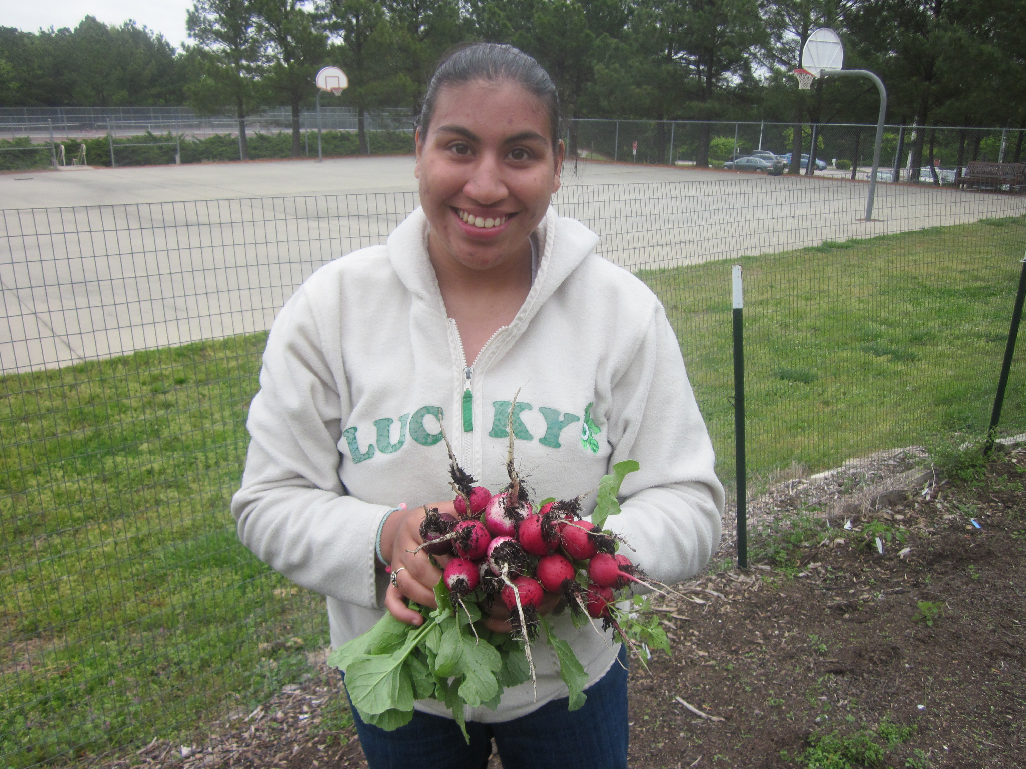
Radish Cultivation
Radish Prezi

Slide 9
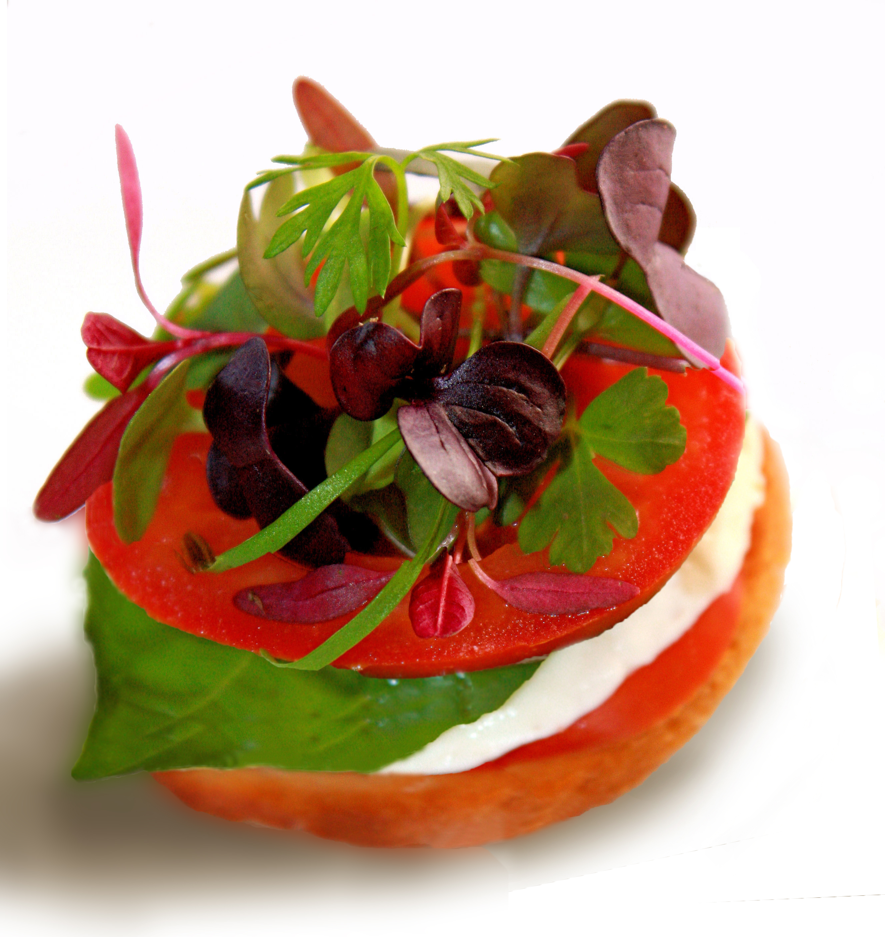
Micro Greens
Delicious, nutritious, inexpensive & fast
Micro Greens video
Micro Greens Activity
Micro Greens Piktochart

Slide 10
F is for Fermentation
Scary but exciting!
Tons of probiotics
Natural process
Oldest form of food preservation
Food science
Food safety

Slide 11
F is for fermentation
List of fermented foods
Yogurt, Sourdough, Chocolate, Alcoholic beverages, Pickled Vegetables
Let’s ferment ‘em!
Yogurt
Pickles
Root Beer

Slide 12
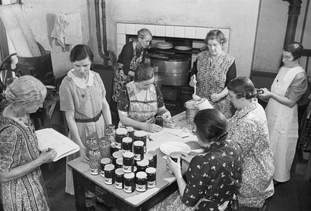
Rockin’ Jam Session
Preservation for a new generation
Natural pectin, low sugar
Acidity
Creating a signature jam
Food safety and storage
Let’s jam, man!

Slide 13
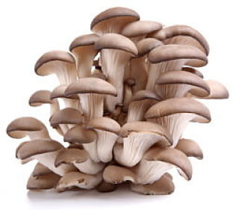
Toilet Paper Shrooms
Fungi- Farm to Fork video
All you need is spawn, toilet paper, and sterile conditions
Mushrooms in 30 days
Oyster mushrooms are the ticket!
$12 per pound
Mushroom Activities

Slide 14
You did it… Farm to Fork in 9 hours
Go to www.wakefieldffa.com and click on Farm to Fork curriculum
jriedel@wcpss.net
Evaluations
Questions?

